Slide 1
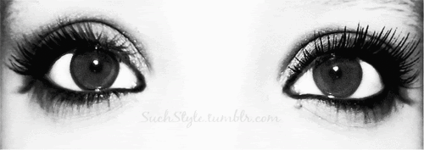
Eyes
Colin Mayer
Jane E

Slide 2
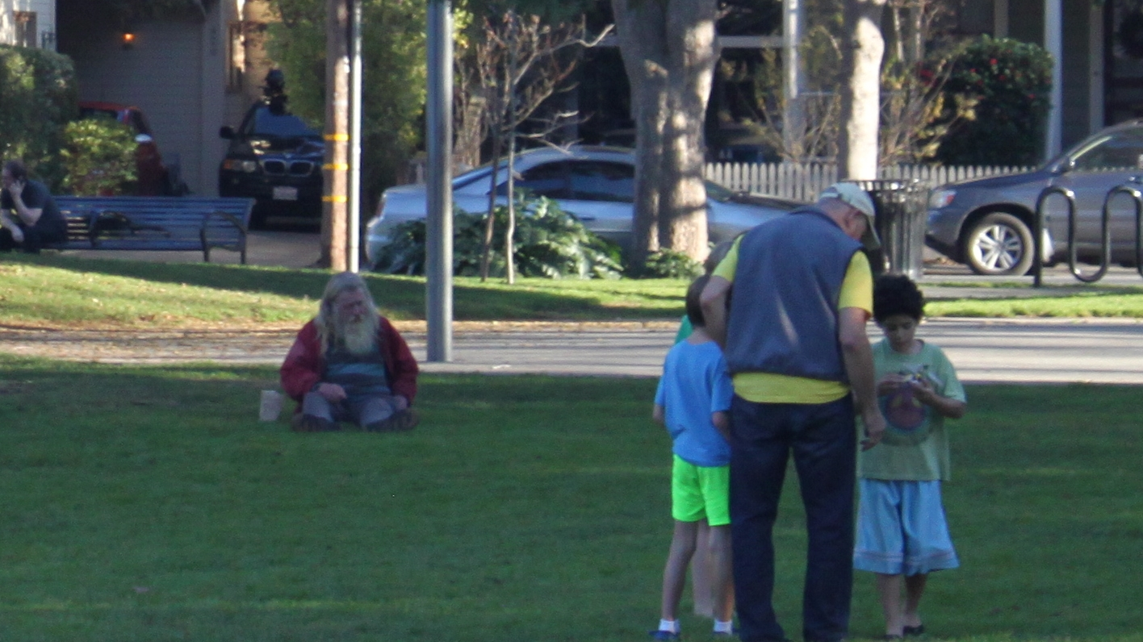

Slide 3

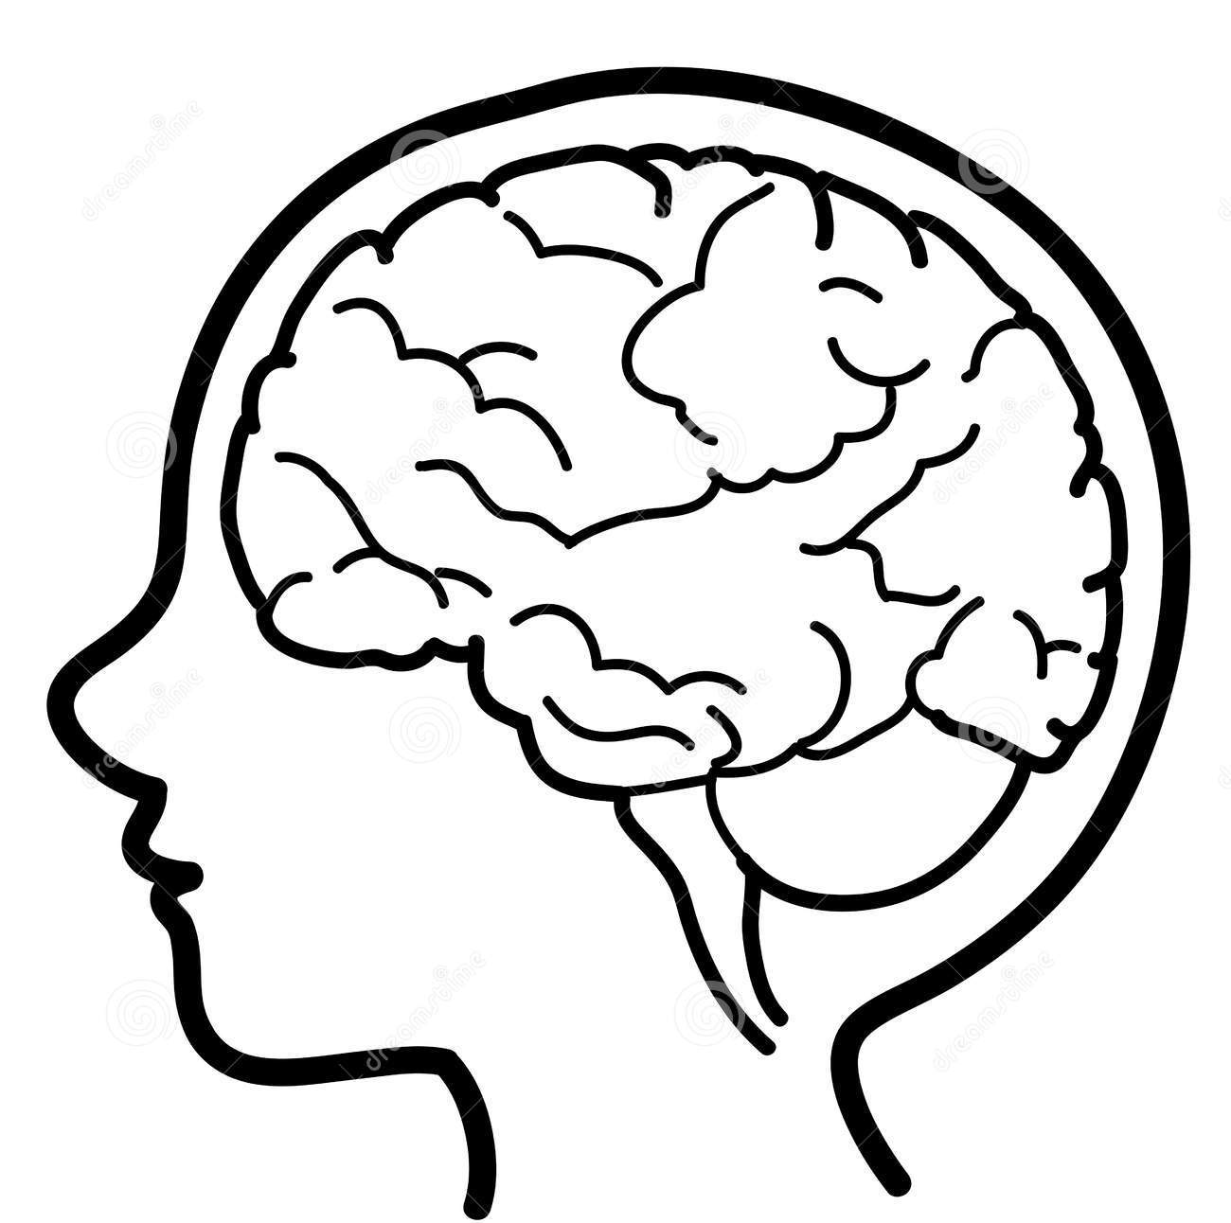
What emotions did that trigger?
How did the change in images influence your perspective?
Context
Notice how context dictated
your response to the content.

Slide 4

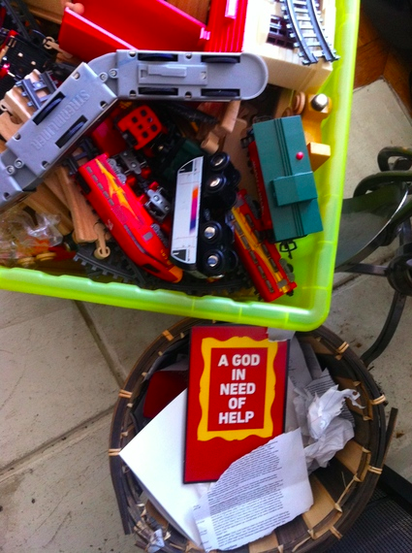

Exhibit A
Author and speaker
Uses imagery as contextual complement
Interesting perspective on capturing images to influence audience

Slide 5


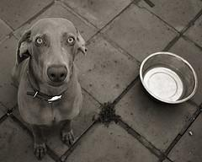

Content
Context
hunger

Slide 6
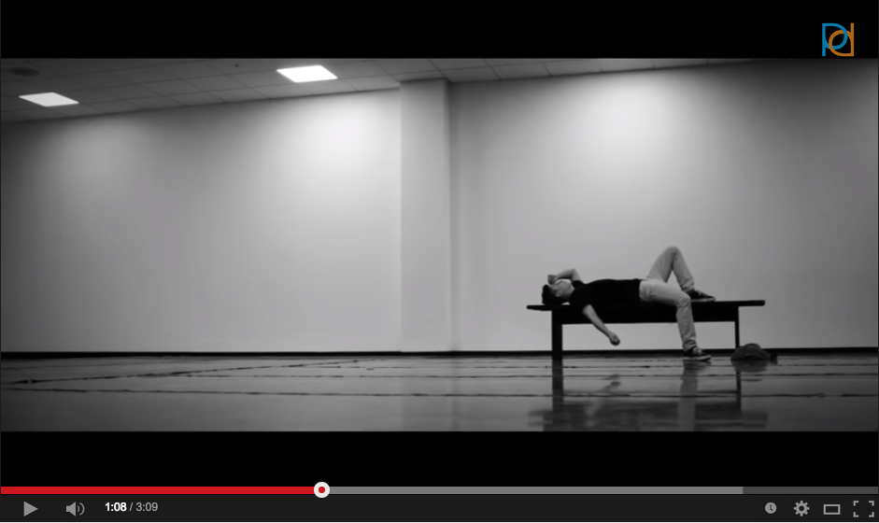
Exhibit B
Videographer, Dancer
Became interested in filmography and the “magic” behind Hollywood early on
Produces a variety of videos mostly for the dance community, but also some just to experiment with effects

Slide 7
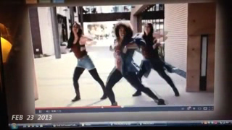

Slide 8
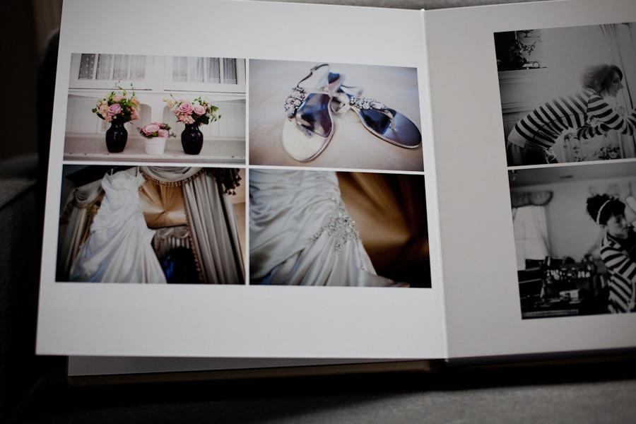


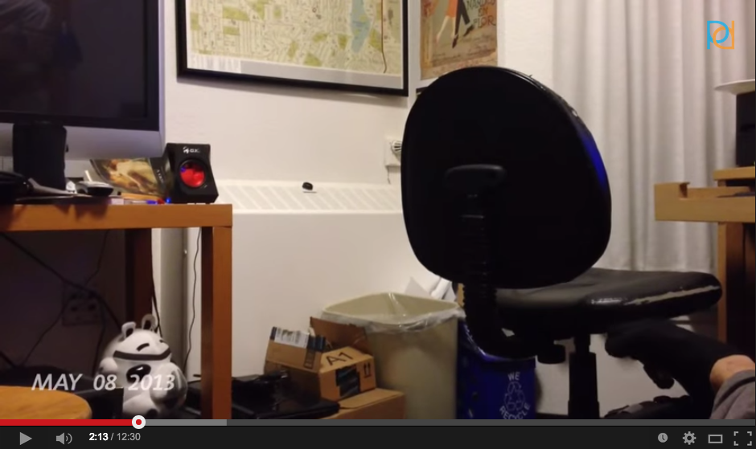
Content
Context
images from a year of life
Notes:
realism vs effects, personal secret code

Slide 9
Background and Needs
Means to capture
visual
auditory
time/moment
Means to experience
albums
slideshows
videos

Slide 10
Solution
Something like Google Glass?
Capture random moments based on analyzing activity in frame
Natural, untainted

Slide 11

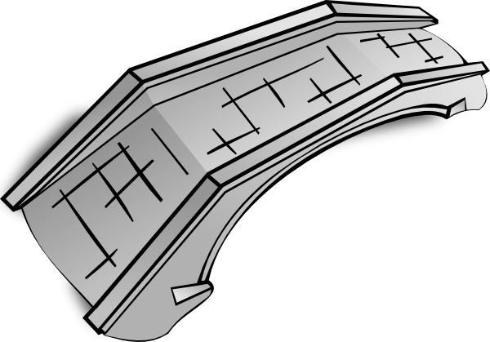

Bridging the gap…
The context of an image/video is specifically constructed to influence our perspective on the past
Future
unkown
unseen
unexperienced
Past
The future is unknown to us and our perspective is shaped by our experiences and our environment

Slide 12
Our perspective on the uncertain is ingrained in our DNA, but it is easily manipulated and we can use it to control our own future.

Slide 13
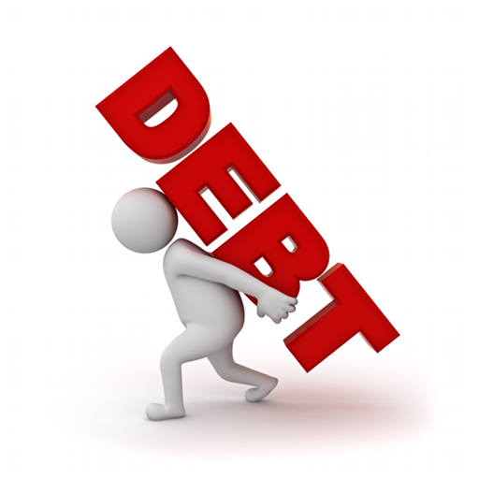



Notes:
One of my interviewees had conducted research on the american approach to uncertainty
To some extent we all bought into the american dream, a college education, a new house etc.
To do this we took an exorbitant amount of debt, for only the promise of future reward
The uncertainty of the future does not scare or deter us
He contrasted this with the rest of the world and found things to be very different
Taking on debt for education or buying a house on credit is unheard of
Lets explore why

Slide 14

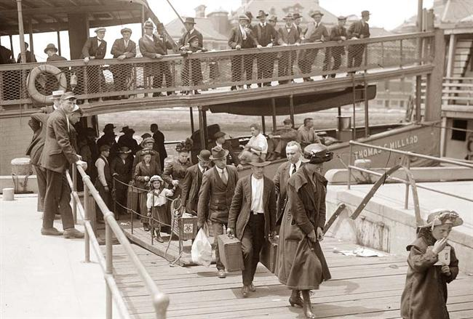
Notes:
America is a land of immigrants
Our ancestors, whether 50 years or 250 years ago, completely split from the familiarity of their homes for the promise of the better future in america
They all were willing to take on the uncertainty, that perhaps those who stayed behind were not
I say this perspective is in our DNA, because in a way we have evolved into those who will take on more uncertainty, because our parents and their parents before them did and they created an environment that encourages that behavior
While our perspective towards the unknown and the future is in our DNA it is also easily manipulated

Slide 15


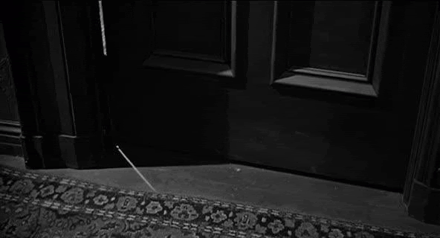
Notes:
Absorb these images, let them shape your perspective and how you approach the uncertainty of the opening door.

Slide 16
Manipulating Our Own Perspective
See how easily your perspective can be manipulated in 20 seconds
This isn’t new:
Positive thinking, The Secret
5 minute journal
Horoscopes
Notes:
You saw how easily your perspective could be manipulated in 20 seconds
Door 1 vs Door 2
This approach isn’t new

Slide 17
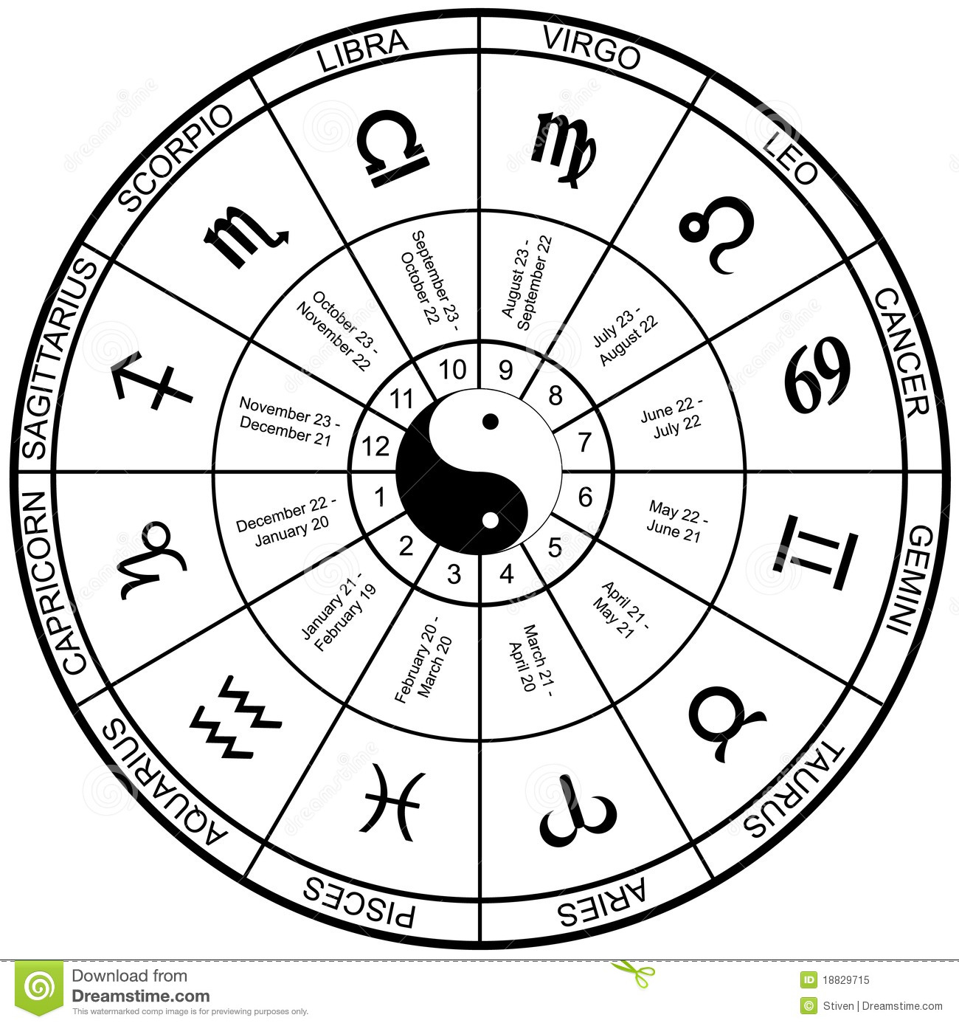
Allison
DAILY HOROSCOPE
Engineering and design background
UX Designer at a tech company
Reads her horoscope everyday
Gemini: As Orion comes into alignment with
Jupiter your luck will favor new agreements
1 Unread Message:
Your new contract is on
my desk, please come by
as soon as possible to
sign...
DAILY HOROSCOPE
Gemini: With Saturn on the dark side of the
moon it is a poor time for business decisions
Notes:
In depth interview with Allison,
Scientific background, but she reads her horoscope everyday
Told this story how if her horoscope adivised her too she would expedite or delay signing important documents
We see that reading her horoscope, and the perspective it gave her on the day directly effected her actions and the perceived results

Slide 18





Daily Astrology
Columns
Daily Astronomy
Columns
Notes:
Might think Allison is alone in this, but she’s not
Despite extensive research refuting the validity of horoscopes they remain immensely popular
The famous astronomer Carl Sagan points out that “Every newspaper has a daily/weekly astrology column, but you won’t find one with even a monthly column astronomy”
He attributes this to people searching for a deeper connection with cosmos, but I disagree. From my investigation it seems that people are looking for help in dealing with the unkown, searching for a new and hopefully better perspective on their futures

Slide 19
Embracing Uncertainty
Most people don’t have an orchestrated approach to the unkown
Influencing people’s perspective on the unknown can effect how they percieve the day’s outcome
This is why people read horoscopes, write in journals or follow The Secret
These efforts are most succesful if they quantify the effect, instead of trying to explain the cause
Let’s create a horoscope for scientists
Notes:
How can we leverage this into a product or a market

Slide 20

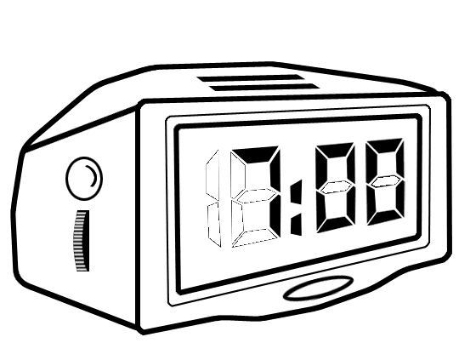
Solution
Alarm clock (physical or virtual) which provides a calibrated perspective to every morning
Something
Insightful…
Perspectives can be:
quotes, poems, videos
Themes can be:
uplifting, reassuring, realistic (not everyday is a good day)

